Slide 1
Good Afternoon To All

Slide 2
Excretory System
Many unwanted products are produced in the body during its activities. Such waste products must be removed out otherwise they harm the body. So following are the major organs of the excretory system.

Slide 3
The Kidney:
The kidney is similar to beans in shape, and is located in the lower abdomen, just above the waist. An average sized of an adult kidney is about 11.25cm in length, 5 to 7.5cm in width and 2.5cm in thickness. Usually the left kidney is little bigger than the right kidney. The concave sides of both kidneys face each other. The inner and middle surface contains a V-shape called the helium. At the helium blood vessels, nerves and hymphatics enter and leave the kidneys. The outer portion of the kidney is called cortex, which is covered by white fibrous tissues. The inner portion is called the medulla. The kidney consists of a large numbers of coiled tubes called nephrons. Nephrons are the tiny filtering units of the kidney.
Functions:
It filters the excess water, salt and urea from the blood.
Excrete urine.

Slide 4
Ureters:
The two ureters are tubes of 10 to 12 inches in length and less than 0.5 inch in diameter. They connect the kidneys with back surface of the bladder.
Function:
Ureters collect urine as it forms and drain it into the bladder.

Slide 5
Urinary Bladder:
The urinary bladder is a collapsible bag located in the pelvic cavity just behind the pubic bones. It is folded when it is empty and stretch as it is filled with urine. It is bounded by the openings from the ureters at the back and the opening into the urethra in the front.
Functions:
It serves as a store for urine before it leaves the body.
It expels urine from body by way of urethra called urination.

Slide 6
Urethra:
The urethra is the tube through which urine flows out of the body. In males the urethra is part of both urinary system and reproductive system. Originating at the base of the bladder, it passes through the prostate gland when it joined by reproductive ducts. From the prostate the urethra passes through the penis. The female urethra is only excretory in function. It is about 1.5 inch long and located just in front of the vagina.
Functions:
In female it is passageway for passing out urine from the body.
In male it is passageway for passing out urine as well as reproductive fluid (semen).

Slide 7
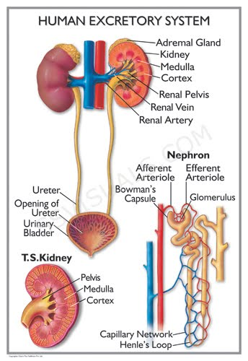

Slide 8
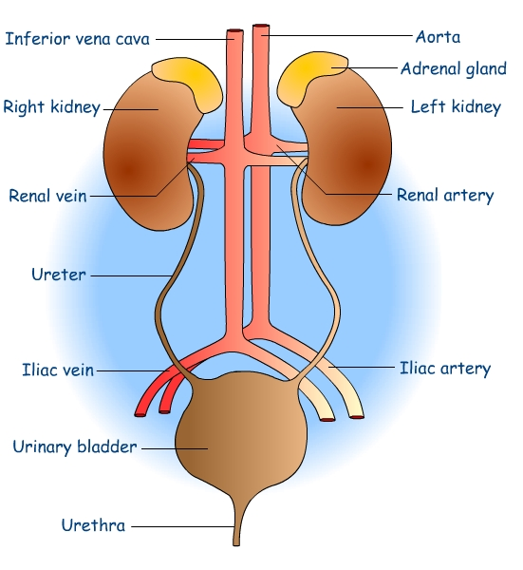

Slide 9
Hambai

